Slide 1
Deaths – ONS Data – UPDATE
ONS have released (as of 12/05/2020) weekly deaths broken down to local authority level, of all deaths and COVID-19 deaths. This dataset will be published every week and includes deaths outside of hospital.
Weekly deaths have been provided for 2020 and from March 31 COVID-19 deaths relate to any death involving coronavirus (COVID-19), based on any mention of COVID-19 on the death certificate.
Two sets of tables are presented, one set based on the date of registration and one set based on date of occurrence of death. Two sets have been provided as there can be a time lag between a death taking place and the subsequent registration. The tables include deaths that occurred up to 1 May but were registered up to 9 May. This does mean that there may be some revisions to the dataset, notably in relation to deaths by date of occurrence as registrations are subsequently made. These slides relate to date of occurrence not registration
In the main data are provided at West Sussex level (given small numbers, at present, below this in terms of COVID), ONS release data at lower tier authority.
Note: Only death, COVID/non-COVID and place (setting of death) and local authority of usual residence are published on a weekly basis. We do not currently have data on age, gender, or underlying condition at this geographical level.
Cumulative data on deaths occurring between 01/03/2020 and 17/04/2020 are available by sex at local level and these will be published as soon as possible.
Jacqueline.clay@westsussex.gov.uk
0330 222 8684
Please call if you have queries about the data in the slides

Slide 2
Deaths – ONS Data – Overall Table – Deaths by Date of Occurrence
All cause deaths | Week ending
 | w/e 3rd Jan | w/e 10th Jan | w/e 17th Jan | w/e 24th Jan | w/e 31st Jan | w/e 7th Feb | w/e 14th Feb | w/e 21st Feb | w/e 28th Feb | w/e 6th Mar | w/e 13th Mar | w/e 20th Mar | w/e 27th Mar | w/e 3rd Apr | w/e 10th Apr | w/e 17th Apr | w/e 24th Apr | w/e 1st May
Brighton and Hove | 44 | 41 | 38 | 41 | 40 | 36 | 33 | 38 | 35 | 56 | 32 | 37 | 60 | 62 | 63 | 69 | 61 | 36
East Sussex | 166 | 161 | 153 | 142 | 142 | 146 | 137 | 120 | 110 | 118 | 114 | 129 | 133 | 133 | 168 | 182 | 198 | 168
West Sussex | 212 | 214 | 183 | 194 | 200 | 182 | 193 | 201 | 194 | 200 | 176 | 181 | 200 | 242 | 299 | 304 | 315 | 258
Sussex areas combined | 422 | 416 | 374 | 377 | 382 | 364 | 363 | 359 | 339 | 374 | 322 | 347 | 393 | 437 | 530 | 555 | 574 | 462
Covid-19 | Week ending
 | w/e 3rd Jan | w/e 10th Jan | w/e 17th Jan | w/e 24th Jan | w/e 31st Jan | w/e 7th Feb | w/e 14th Feb | w/e 21st Feb | w/e 28th Feb | w/e 6th Mar | w/e 13th Mar | w/e 20th Mar | w/e 27th Mar | w/e 3rd Apr | w/e 10th Apr | w/e 17th Apr | w/e 24th Apr | w/e 1st May
Brighton and Hove |  |  |  |  |  |  |  |  |  |  |  | 1 | 6 | 16 | 21 | 25 | 19 | 14
East Sussex |  |  |  |  |  |  |  |  |  |  |  | 2 | 10 | 22 | 41 | 47 | 53 | 36
West Sussex |  |  |  |  |  |  |  |  |  |  |  | 3 | 19 | 37 | 80 | 88 | 110 | 68
Sussex areas combined |  |  |  |  |  |  |  |  |  |  |  | 6 | 35 | 75 | 142 | 160 | 182 | 118
Non-Covid-19 | Week ending
 | w/e 3rd Jan | w/e 10th Jan | w/e 17th Jan | w/e 24th Jan | w/e 31st Jan | w/e 7th Feb | w/e 14th Feb | w/e 21st Feb | w/e 28th Feb | w/e 6th Mar | w/e 13th Mar | w/e 20th Mar | w/e 27th Mar | w/e 3rd Apr | w/e 10th Apr | w/e 17th Apr | w/e 24th Apr | w/e 1st May
Brighton and Hove | 44 | 41 | 38 | 41 | 40 | 36 | 33 | 38 | 35 | 56 | 32 | 36 | 54 | 46 | 42 | 44 | 42 | 22
East Sussex | 166 | 161 | 153 | 142 | 142 | 146 | 137 | 120 | 110 | 118 | 114 | 127 | 123 | 111 | 127 | 135 | 145 | 132
West Sussex | 212 | 214 | 183 | 194 | 200 | 182 | 193 | 201 | 194 | 200 | 176 | 178 | 181 | 205 | 219 | 216 | 205 | 190
Sussex areas combined | 422 | 416 | 374 | 377 | 382 | 364 | 363 | 359 | 339 | 374 | 322 | 341 | 358 | 362 | 388 | 395 | 392 | 344

Slide 3
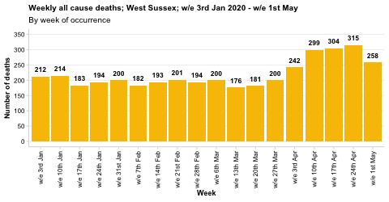
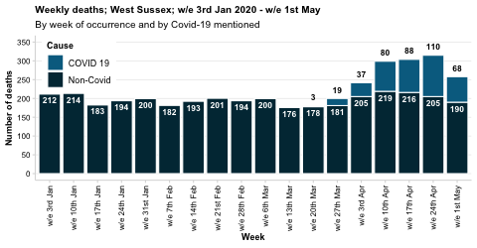
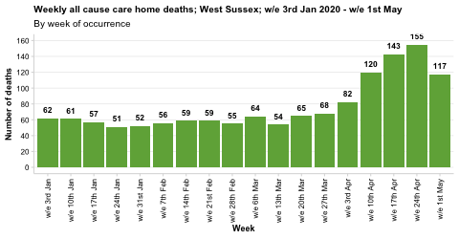
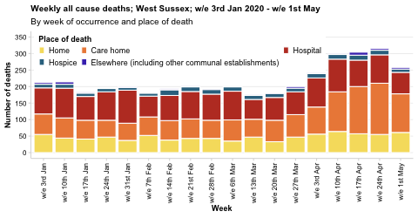
Source: Office for National Statistics

Slide 4
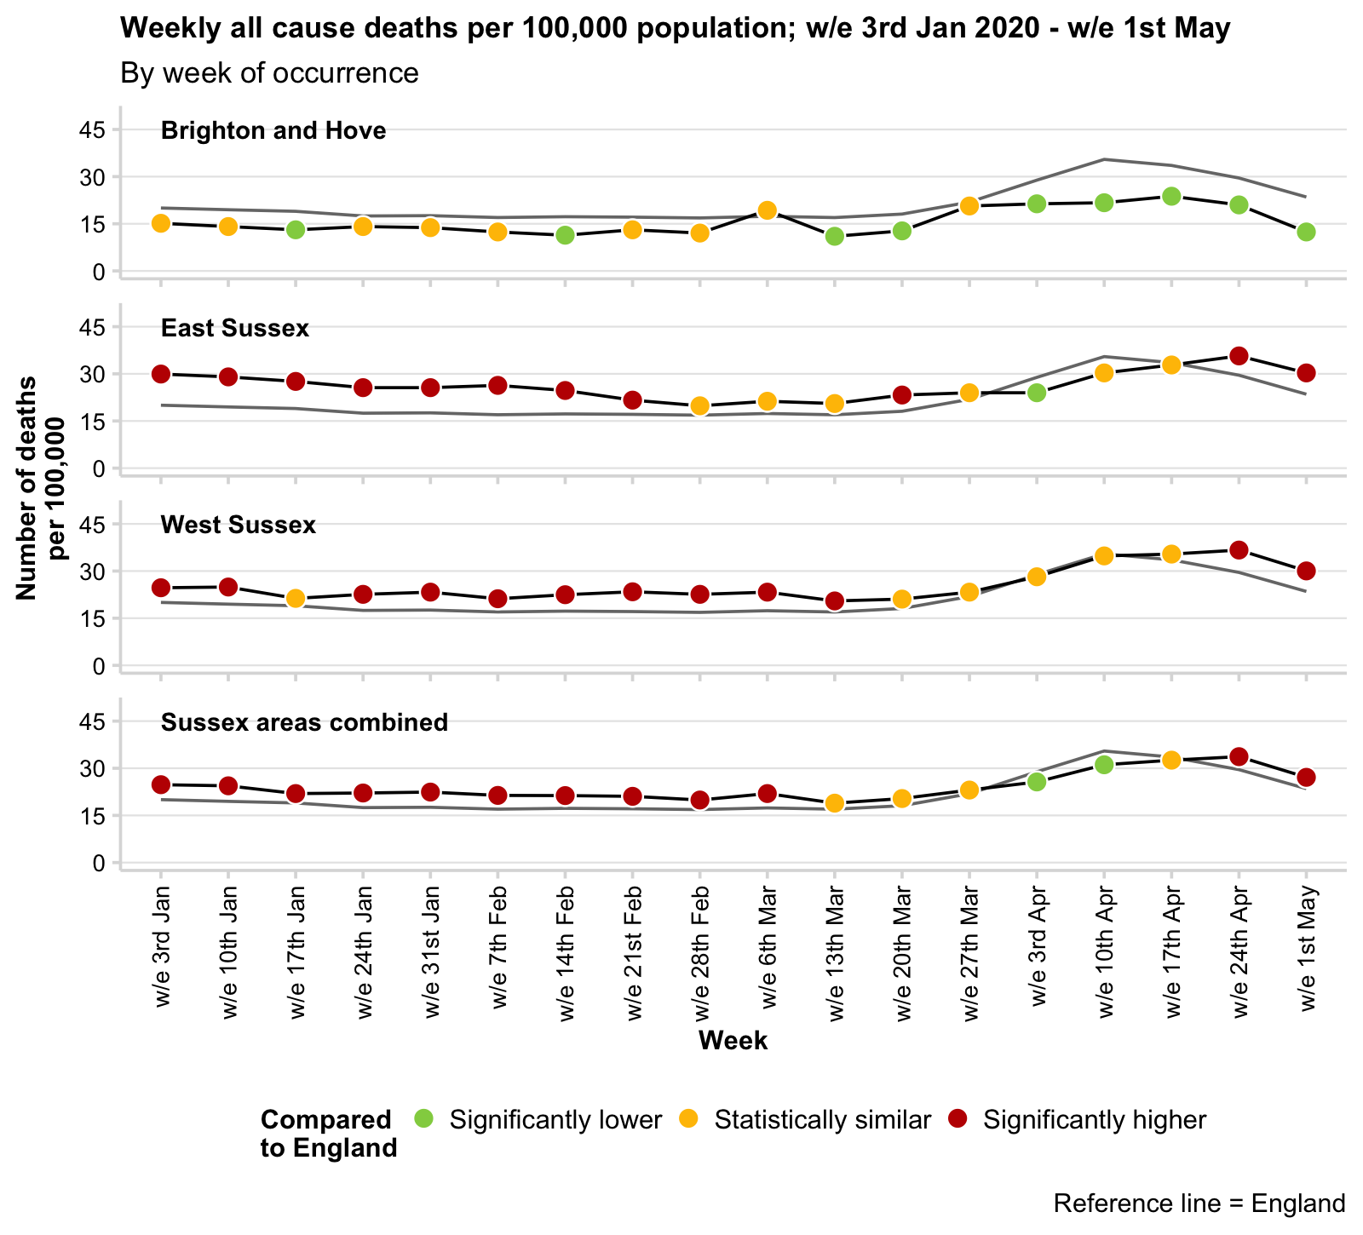
Crude rate of all cause mortality; to week ending 01/05/2020
A crude rate is calculated using the mid-2018 population estimates (all ages) for each area. Note that West Sussex has an older population compared with England and so the rate is usually, and expectedly, above the national rate.
An age/sex standardised rate is not currently available for the weekly ONS release, although cumulative data for a shorter time period are available on the next slide.
The crude rate of death has risen considerably nationally and locally.
This increase started towards the end of March but appears to be declining in some areas.
This graph shows the considerable increase at a national level, so that local and national crude rates are similar.

Slide 5
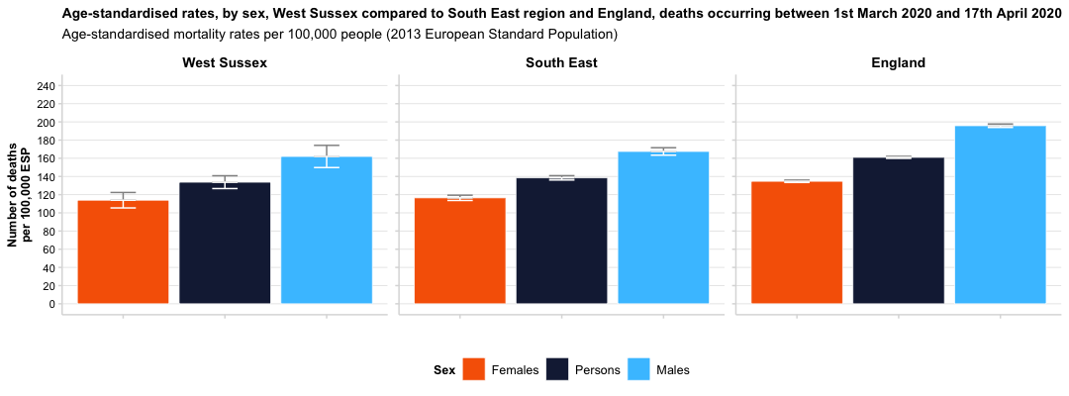
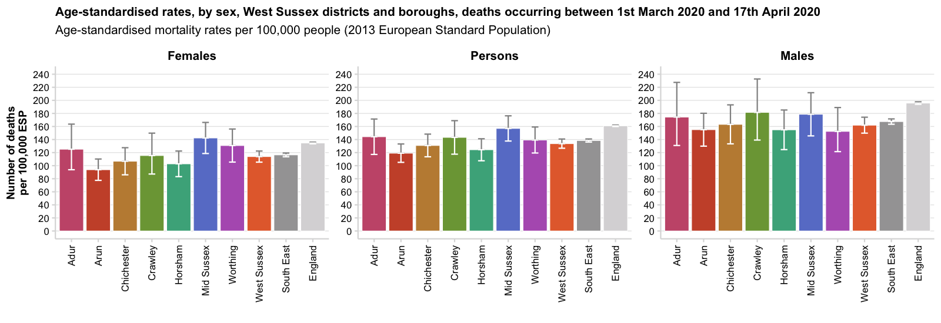
All cause mortality; occurring 01/03/2020 – 17/04/2020
Area | Deaths (persons)
Adur | 110 deaths (144.3 per 100,000 ESP, 95% CI: 117.2-171.4)
Arun | 285 deaths (119.1 per 100,000 ESP, 95% CI: 105.1-133.2)
Chichester | 227 deaths (130.9 per 100,000 ESP, 95% CI: 113.6-148.3)
Crawley | 123 deaths (143.3 per 100,000 ESP, 95% CI: 117.6-168.9)
Horsham | 212 deaths (124.4 per 100,000 ESP, 95% CI: 107.5-141.2)
Mid Sussex | 258 deaths (157 per 100,000 ESP, 95% CI: 137.7-176.3)
Worthing | 194 deaths (139.3 per 100,000 ESP, 95% CI: 119.4-159.2)
West Sussex | 1,409 deaths (133.7 per 100,000 ESP, 95% CI: 126.7-140.8)
South East | 13,024 deaths (138.5 per 100,000 ESP, 95% CI: 136.1-140.9)
England | 84,908 deaths (161 per 100,000 ESP, 95% CI: 159.9-162.1)

Slide 6
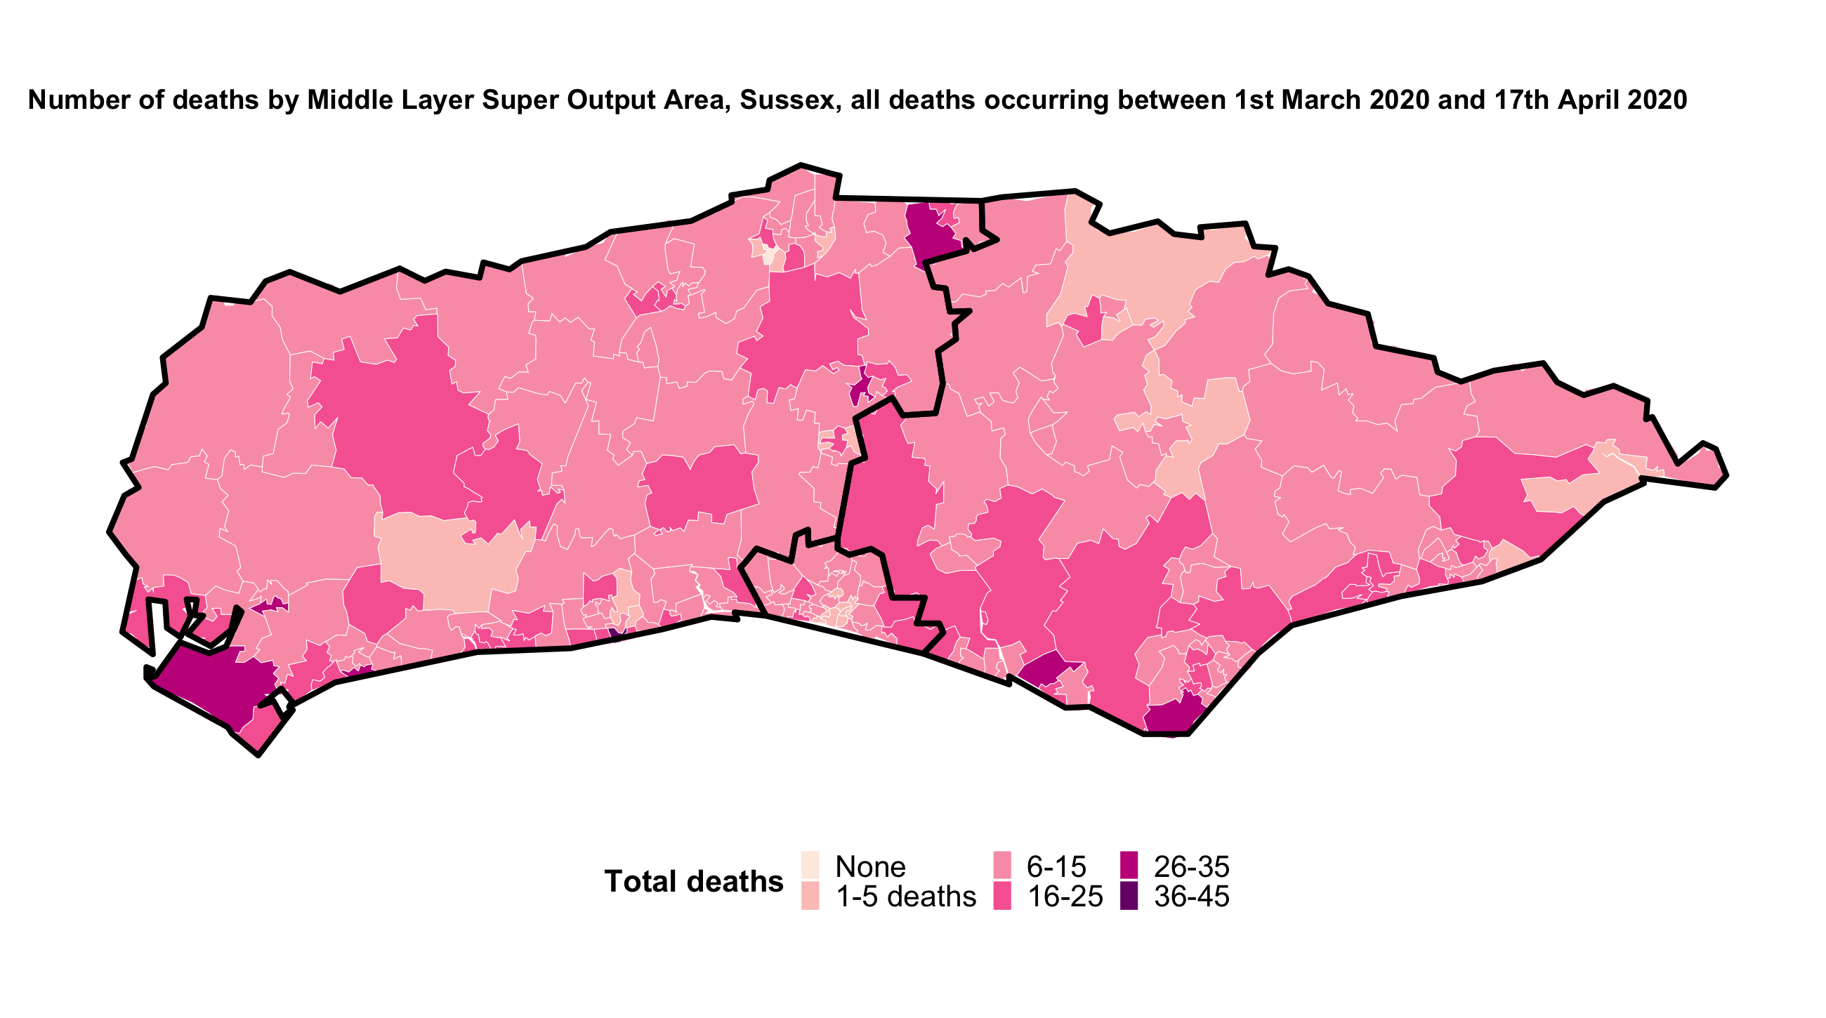
All cause mortality; occurring 01/03/2020 – 17/04/2020

Slide 7
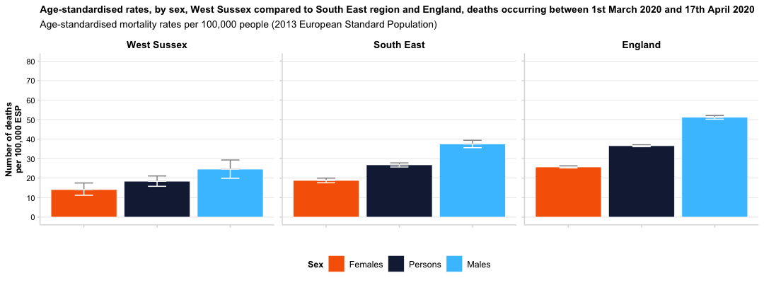
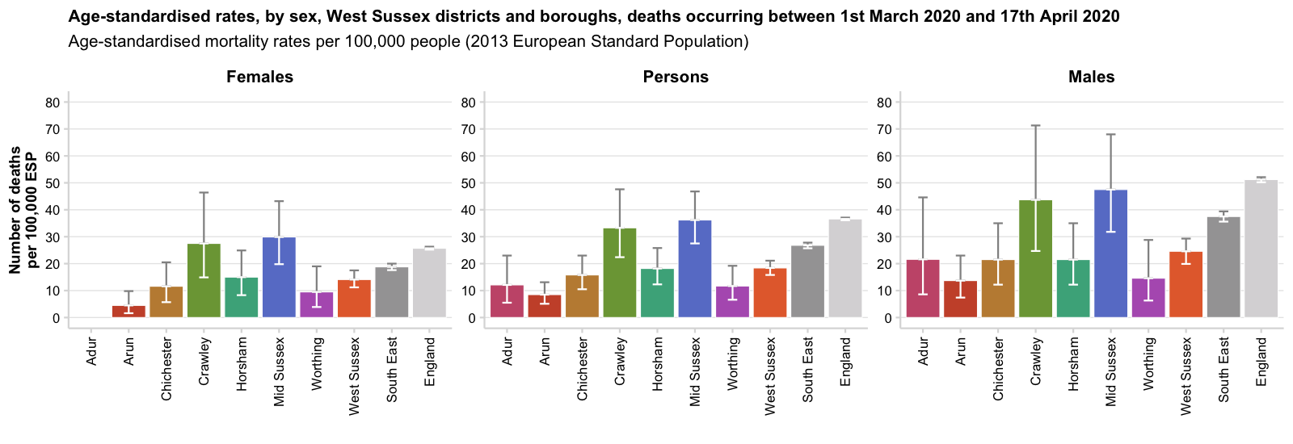
Covid-19 mortality; occurring 01/03/2020 – 17/04/2020
Area | Deaths (persons)
Adur | 9 deaths (12.1 per 100,000 ESP, 95% CI: 5.5-23)
Arun | 20 deaths (8.5 per 100,000 ESP, 95% CI: 5.1-13.1)
Chichester | 28 deaths (15.8 per 100,000 ESP, 95% CI: 10.5-23)
Crawley | 30 deaths (33.3 per 100,000 ESP, 95% CI: 22.4-47.6)
Horsham | 31 deaths (18.2 per 100,000 ESP, 95% CI: 12.3-25.8)
Mid Sussex | 59 deaths (36.2 per 100,000 ESP, 95% CI: 27.5-46.8)
Worthing | 16 deaths (11.7 per 100,000 ESP, 95% CI: 6.6-19.2)
West Sussex | 193 deaths (18.4 per 100,000 ESP, 95% CI: 15.8-21.1)
South East | 2,508 deaths (26.8 per 100,000 ESP, 95% CI: 25.7-27.8)
England | 19,315 deaths (36.6 per 100,000 ESP, 95% CI: 36.1-37.1)

Slide 8
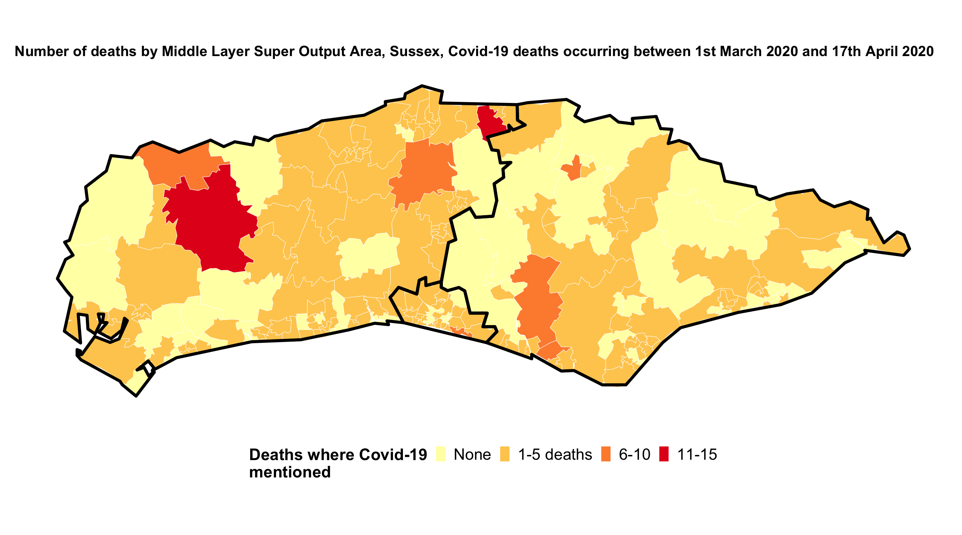
Covid-19 mortality; occurring 01/03/2020 – 17/04/2020

Slide 9
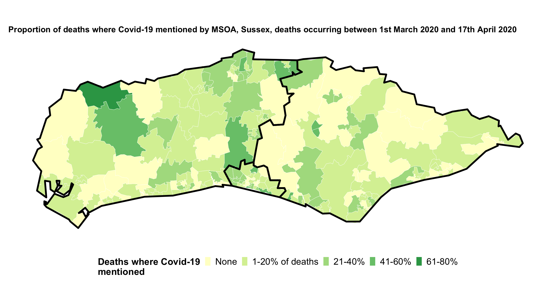
Covid-19 mortality; occurring 01/03/2020 – 17/04/2020

Slide 10
Care homes

